Slide 1
Paritty
HACKRU 2026 · REGENERON CLINICAL CHALLENGE
Continuous clean-to-lock copilot for clinical trials
Best Use of Gemini
Best Use of Tiger Data
Notes:
Paritty cleans clinical trial data every day instead of at the end, and forecasts the database lock date. Gemini drafts, deterministic code verifies, and a person approves. Tiger Data's Postgres runs search, time series and evaluation forks in one place.

Slide 2
Cleanup starts too late.
THE PROBLEM
36+
Up to
$1,000,000 a day
in lost patent life for a blockbuster drug
Patients wait longer for life-saving therapies.
days between the last patient's last visit and database lock
Source: Tufts Center for Drug Development industry average, last patient last visit to database lock
Notes:
Today, data cleaning starts after the last patient finishes. The industry average from the Tufts Center is 36+ days from last patient last visit to database lock, and for a blockbuster drug each day of delay can cost up to $1,000,000 in lost patent life. Meanwhile patients wait longer for therapies.

Slide 3
Clean continuously, not at the end.
THE IDEA
TRADITIONAL TRIAL
PARITTY
Data sits unchecked for months
→
New visits are audited within 24 hours of entry
Queries sent to sites months after the visit
Queries drafted immediately, while memories are fresh
→
Manual reconciliation between databases
→
Fuzzy reconciliation runs daily
Guessing the final lock date
→
A Monte Carlo simulation projects the lock date
Paritty · Continuous clean-to-lock copilot for clinical trials
Notes:
A trial has 404 patients across 24 sites, feeding the EDC, an outside lab and a separate safety database. Traditionally errors pile up silently until the end. Paritty audits every new visit within 24 hours, drafts queries while memories are fresh, reconciles the databases daily and forecasts the lock date with a Monte Carlo simulation.

Slide 4
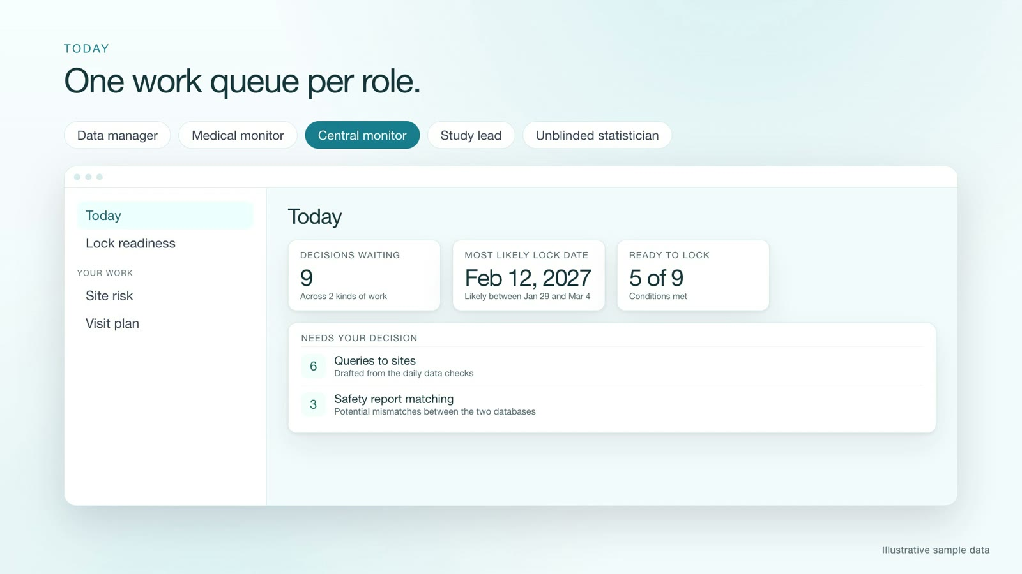
One work queue per role.
TODAY
Role | Starts from
Data manager | Queries, checks, matching
Medical monitor | Medical review, liver safety, trends
Central monitor | Site risk, visit plan
Study lead | Suggested actions
Unblinded statistician | Liver safety
Today screen, from the walkthrough video. Sample data.
Paritty · Decisions waiting, most likely lock date, and what is ready to lock, in one place
Notes:
The Today page shows decisions waiting, the most likely lock date and how many lock conditions are met. Each of the five roles starts from its own queue in the sidebar, and everything else stays one click away.

Slide 5
Every row checked the day it arrives.
DATA CHECKS AND QUERIES
25+
0.95
Gemini
built-in checks
priority for an unreported death
drafts, a person approves
Dates, ranges, doses and duplicates, run on every new visit.
Queries are drafted and translated for international sites. Numbers, dates and IDs are verified.
A misspelled surname scores 0.1. Critical issues are reviewed first.
Draft
→
Approved by human
→
Sent to hospital
→
Answered by site
→
Closed
Reopened if the check still fails.
Paritty · Edit checks and the query lifecycle
Notes:
More than 25 deterministic checks cover chronology, physiological limits, protocol adherence and duplicates. Every issue gets a critical-to-quality priority so a misspelled surname scores 0.1 and an unreported death scores 0.95. Gemini drafts the query and its translation, deterministic code verifies it, and a person approves before anything is sent.

Slide 6
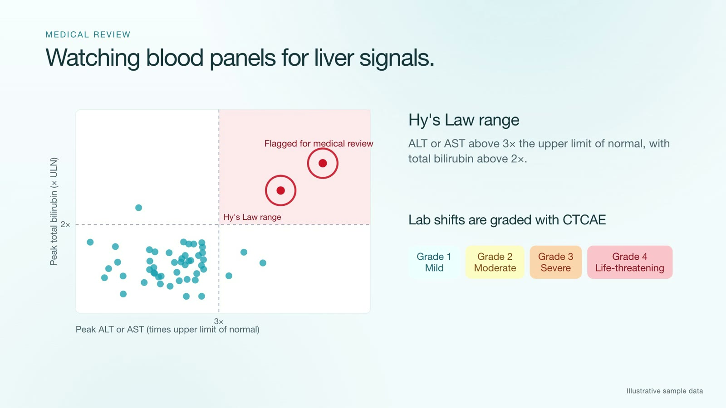
Safety, labs and liver signals.
RECONCILIATION AND MEDICAL REVIEW
TWO DATABASES, ONE TRUTH
EDC
Safety database
Acute myocardial infarction
=
Heart attack
Acceptable
A spelling difference, clinically identical
Actionable
Onset date differs by 3 days
Critical
Fatal in one system, mild in the other
Central lab matching also flags unit mix-ups such as mg/dL versus mmol/L.
Hy's Law range: ALT or AST above 3× the upper limit of normal with bilirubin above 2× is flagged for medical review.
Paritty · Sample data from the walkthrough video
Notes:
Doctors report serious adverse events to two systems, and if terms, dates or severity disagree the filing is at risk. Paritty matches events with fuzzy string matching and synonyms, triages differences as acceptable, actionable or critical, and compares clinic and central lab values. The medical review module watches blood panels with an eDISH plot for Hy's Law and grades lab shifts with CTCAE, Grade 1 mild to Grade 4 life-threatening.

Slide 7
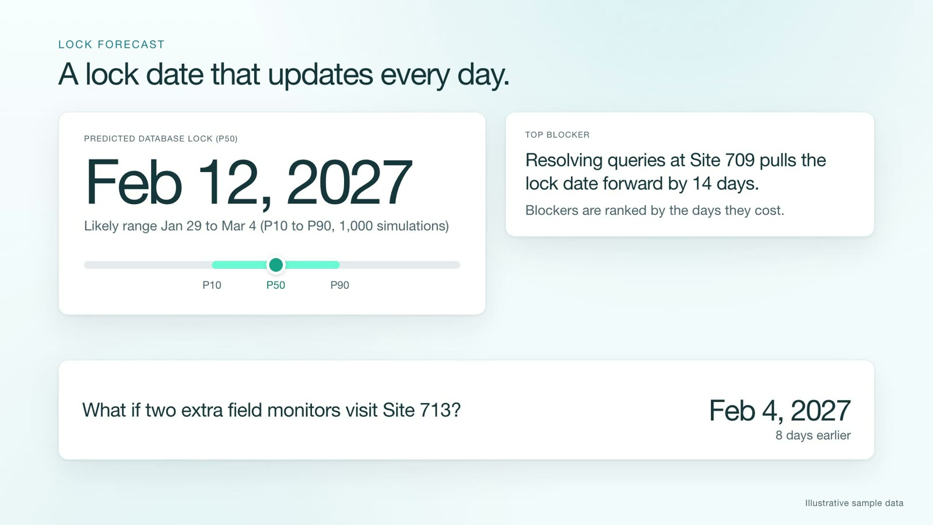
Spot risk early. Know the lock date.
SITE RISK AND LOCK FORECAST
EIGHT KEY RISK INDICATORS
Protocol deviations
Adverse event reporting
SAE reporting delay
Query response time
Queries reopened
Screen failure rate
Visit adherence
Missing data
A machine-learning model turns them into a 0 to 100 site risk score.
Visit agenda
Follow-up letter
Scorecard PDF
Drafts only. A person approves.
Lock date from 1,000 simulations, with a P10 to P90 range. Blockers are ranked by days saved, and a what-if tests extra monitors at a slow site.
Paritty · Sample data from the walkthrough video
Notes:
Site monitoring tracks eight key risk indicators and a trained model scores each site 0 to 100, then drafts a visit agenda, a follow-up letter and a scorecard PDF for a person to approve. The lock forecast runs 1,000 Monte Carlo simulations, reports P10, P50 and P90, ranks blockers by days saved and lets a director test what-ifs, such as sending two extra monitors to a slow site.

Slide 8
Four more tools for the team.
AND MORE
ASK THE PROTOCOL
DATA HUB
Answers with citations
One patient, one record
Hybrid search finds exact terms and meaning. Questions that need medical judgment go to the Medical Monitor, not a guess.
SUBJ-001, PT-1001 and USUBJID-901-01 resolve to the same person. 46 study tables are cataloged, and plain-English questions become read-only SQL.
SUGGESTED ACTIONS
ACCURACY TESTS
A data-manager agent
Scored on a hidden key
Candidate actions are scored by the what-if forecast. Gemini words the rationale. A person approves every action.
238 planted anomalies. The detection code cannot read the answer key.
Paritty · Protocol Q&A, data hub, agent and evaluation harness
Notes:
The protocol assistant blends BM25 and vector search and escalates anything needing medical judgment. The data hub resolves conflicting identifiers and turns natural-language questions into guarded read-only SQL. The agent proposes actions scored by the what-if forecast, and the evaluation harness scores every detector against 238 planted anomalies it cannot see.

Slide 9
Gemini drafts. Code verifies. People approve.
BEST USE OF GEMINI
Deterministic checks
Gemini drafts
Code verifies
A person approves
find the issue, no AI involved
the query, translation or note
every quote and row ID is checked
before anything is sent
WHERE GEMINI WORKS
Drafts queries and translates them for sites
WHY IT IS SAFE
Judges borderline term matches
Never sees the treatment arm.
Answers protocol questions with exact quotes
Never writes executable logic.
Assesses causality with cited evidence
Every claim cites table, key and column. A claim that fails verification is blocked.
Turns plain-English questions into read-only SQL
Without Gemini, templates keep every workflow running.
Embeds text for semantic search
Notes:
This is where Gemini earns its place. Detection is deterministic. Gemini 2.5 Flash and Pro draft queries and translations, adjudicate borderline term matches, answer protocol questions with exact quotes, assess causality with cited evidence, and turn plain-English questions into read-only SQL; gemini-embedding-2 powers semantic search. Every Gemini claim must carry citations and pass a deterministic verifier or it is blocked. Gemini never sees the treatment arm and never produces executable logic. A person approves before anything leaves the platform. Note: some Gemini paths were not recorded against live output because of the free-tier quota, so templates stand in for them in replay mode.

Slide 10
One Postgres for the whole trial.
BEST USE OF TIGER DATA
TIGER POSTGRES, ONE SERVICE
FORK THE TRIAL, NOT PRODUCTION
TimescaleDB
Hypertables for visits and labs over time
1 · Fork the Tiger service
2 · Simulate weeks of trial days
pgvectorscale
Embeddings for semantic search
3 · Score against the answer key
pg_textsearch
BM25 for exact drug names and lab limits
4 · Delete the fork
A fork is a whole new service, so evaluations never touch the demo data.
Hybrid search merges both result lists, so one query finds meaning and exact terms.
46
238
2
study tables cataloged in the data hub
planted anomalies scored on forks
targets, one schema: Tiger Cloud and local Docker
Notes:
Tiger Data's Postgres is the single store for the whole system. TimescaleDB hypertables hold visits and labs over time, pgvectorscale holds embeddings, and pg_textsearch provides BM25, and hybrid search merges the two. The evaluation harness forks the database, runs a multi-week simulation, scores it against the planted answer key and deletes the fork, so production data is never touched. The same migrations run unchanged on a Tiger Cloud service and on local Docker. Honest note: a Tiger fork is a whole new service and took about 28 seconds on the free plan, versus a fraction of a second for a local template fork, so Tiger forks are best for a final measured run.

Slide 11
Five rules that never bend.
GUARDRAILS
1
A human approves every query, letter and agenda.
Paritty
2
The treatment arm stays blinded. Unblinded access is logged.
Continuous clean-to-lock copilot for clinical trials
3
Every Gemini claim carries citations and is verified.
Watch the 4-minute walkthrough
4
Neutral wording: "potential discrepancy", "reason to look".
github.com/moh0405/paritty, walkthrough_video
5
Every state change writes to the audit log.
Built with Gemini and Tiger Data for HackRU 2026
Notes:
Close on the guardrails: humans approve everything, the treatment arm stays blinded, every Gemini claim is cited and verified, wording stays neutral, and every state change is audited. Then point judges to the 4-minute walkthrough video in the repository.

